Slide 1
Class Six–Logistic regression as a classifier
Kim Johnson

Slide 2
Learning objectives
Review of sensitivity, specificity, positive and negative predictive values
Understand distinction between use of logistic regression for risk prediction vs. classification
Understand how ROC curves can be used to evaluate model classification performance
Understand limitations of logistic as a classifier

Slide 3
What is validity?
The ability of a test to distinguish between who has a disease and who does not (Xzklo and Nieto)

Slide 4
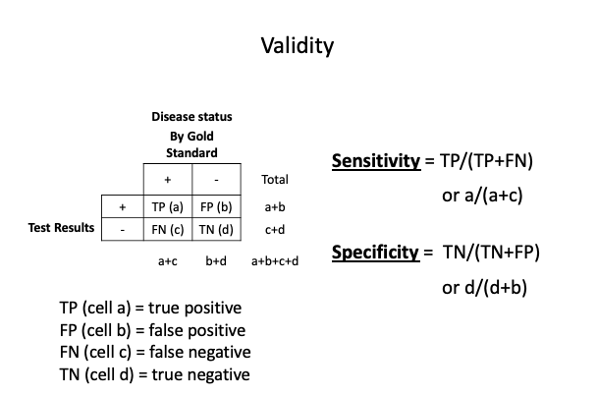
Recall 2 x 2 table set-up for calculating measures of validity
Sensitivity and Specificity

Slide 5
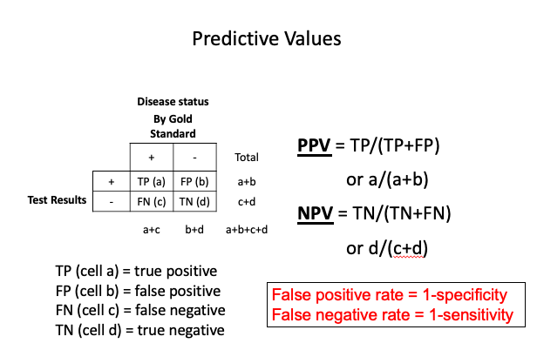
Positive and negative predictive values
Predictive values

Slide 6
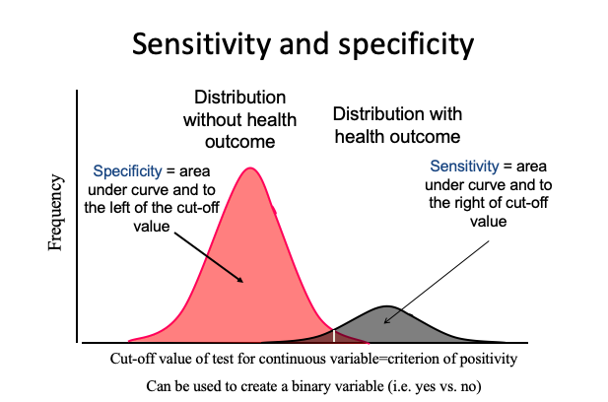
Cutpoints for continous variables impact on sensitivity and specificity
Thresholds

Slide 7
Prediction vs. classification
Prediction is a tendency (probablistic) of whether a condition or set of conditions poses a higher or lower risk of a characteristic
Classification is a decision of whether a condition or set of conditions indicates a a characteristic or not
In epidemiology and biostatistics, most of our work deals with prediction or associations rather than classification
“When close calls are possible, or when there is inherent randomness to the outcomes, probability estimates are called for.” (https://www.fharrell.com/post/classification/)

Slide 8
Logistic regression
We can use a logistic regression model to help distinguish between those who have a characteristic and those who do not have a characteristic
In this case we are using it as a classifier rather than a model to estimate associations between an exposure and an outcome
We can evaluate the validity of the model using different measures including sensitivity, specificity, PPV, accuracy, Receiver operating characteristic curves (ROC) and AUC values

Slide 9
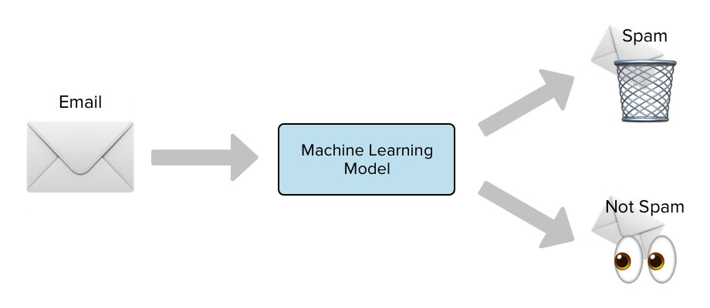
Examples
Spam email or not?

Slide 10
- opiod misuse or not? https://www.ncbi.nlm.nih.gov/pubmed/31899451

Slide 11
Let’s use logistic regression as a classifier for diabetes in the BRFSS dataset
#install.packages("tidyverse") #install.packages("haven") #install.packages("ROCR") #install.packages("odds.n.ends") library(dplyr) library(haven) library(ROCR) library(odds.n.ends) library(ggplot2)

Slide 12
Load dataset
BRFSS <- read.csv("https://raw.githubusercontent.com/kijohnson/ADA_Spring_2019/master/BRFSS2017_10percent_v2.csv")
#check type of variable class(BRFSS$diabetes) #look at number of observations per level table(BRFSS$diabetes)

Slide 13
Let’s combine the no’s and yes’s and exclude “Don’t know/Not sure” and “Refused”
#make a binary diabetes variable categorizing diabetes into yes and no excluding individuals with other responses. BRFSS$diabetes_binary[ BRFSS$diabetes=="No"| BRFSS$diabetes=="No, pre-diabetes or borderline diabetes"]<-0 #Assign 0 to those who responded no or no pre-diabetes/borderline to the diabetes question BRFSS$diabetes_binary[ BRFSS$diabetes=="Yes"|BRFSS$diabetes=="Yes, but female told only during pregnancy"]<-1 #Assign 1 to those who responded yes or yes during pregnancy to the diabetes question BRFSS$diabetes_binary<-factor(BRFSS$diabetes_binary, levels=c(0,1), labels=c("No Diabetes", "Diabetes")) #check to make sure re-classification worked table(BRFSS$diabetes_binary, BRFSS$diabetes) table(BRFSS$diabetes_binary)

Slide 14
Let’s also recode BMI into 4 categories
#recoding BMI to 4 categories BRFSS$bmi_cat[(BRFSS$bmi>0 & BRFSS$bmi<18.5)]<-0 BRFSS$bmi_cat[(BRFSS$bmi>=18.5 & BRFSS$bmi<25)]<-1 BRFSS$bmi_cat[(BRFSS$bmi>=25 & BRFSS$bmi<30)]<-2 BRFSS$bmi_cat[(BRFSS$bmi>=30)]<-3 #make BMI a factor variable BRFSS$bmi_cat<-factor(BRFSS$bmi_cat, levels=c(0:3), labels=c("0 to <18.5 kg/m2", "18.5 to <25 kg/m2", "25 to <30 kg/m2", ">=30 kg/m2")) #checking to make sure recode worked summary(BRFSS$bmi_cat) by(BRFSS$bmi, BRFSS$bmi_cat, summary)

Slide 15
Run a logistic model with diabetes_binary as the dependent variable and bmi_cat as the independent variable
#bmi_cat logistic model bmi_catLogit <- glm(diabetes_binary ~bmi_cat, data=BRFSS, family="binomial") summary(bmi_catLogit) #calculate and print ORs and 95% CIs ORbmi_cat<-exp(cbind(OR = coef(bmi_catLogit), confint(bmi_catLogit))) ORbmi_cat #print ORs and 95% CIs

Slide 16
Get model predicted probabilities that an observation is a 1 vs. a 0
preds<-predict(bmi_catLogit, newdata=BRFSS, type='response') # to get probabilities, if you don't use it you will get log odds head(preds) hist(preds) #the highest predicted probability of having diabetes (a 1) is 0.25. Since the cutoff for classifying something as a 1 in the odds.n.ends package by Dr. Harris is 0.5, we will get 0 predicted cases of diabetes using this model. This model would be terrible at classifying people with diabetes vs. not.

Slide 17
Make dataset of predicted probabilities and true diabetes label, plot probabilities by diabetes, and get sensitivity and specificity
xt<-as.data.frame(preds) xt2<-cbind(xt, BRFSS$diabetes_binary) #plot the distribution of the predicted probabilities for those with and without diabetes ggplot(data=xt2) + geom_density(aes(x=preds, color=BRFSS$diabetes_binary, linetype=BRFSS$diabetes_binary)) odds.n.ends(bmi_catLogit) #This function will show us

Slide 18
A note on model prediction accuracy
Accuracy is akin to % agreement between the model predictions and the true values
The accuracy of the above model is (0+35476)/41383=85.7%. It predicts all 0’s correctly (100% correct) and all 1’s incorrect (0% correct)
Therefore, accuracy is not a good measure for the model’s performance and logistic doesn’t work well as a classifier when the prevalence of the event/outcome is low

Slide 19
What if bmi is treated as a continuous variable? What happens to sensitivity?
bmi_cont_logit <- glm(diabetes_binary ~bmi , data=BRFSS, family="binomial") summary(bmi_cont_logit) preds<-predict(bmi_cont_logit, newdata=BRFSS, type='response') # get predicted probabilities hist(preds) # display histogram of predicted probabilities odds.n.ends(bmi_cont_logit) # look at summary values from model

Slide 20
What if we add a few more predictors? What happens to sensitivity?
bmi_cont_logit2 <- glm(diabetes_binary ~bmi + X_AGE80 + sex, data=BRFSS, family="binomial") # add age and sex summary(bmi_cont_logit2) preds<-predict(bmi_cont_logit2, newdata=BRFSS, type='response') # get predicted probabilities hist(preds) # display histogram of predicted probabilities odds.n.ends(bmi_cont_logit2) # look at summary values from model and get sensitivity and specificity

Slide 21
What happens if we balance the 1s and 0s?
Model performance improves with a balanced dependent variable.
We can balance by undersampling the majority class.
Can we predict more 1’s at a cutoff for predicted probability of 0.5 the default for odds.n.ends (i.e. increase model sensitivity)?
#create new dataset with diabetes_binary= 0 set.seed(1) BRFSS_zero<-sample_n(BRFSS[which(BRFSS$diabetes_binary=='No Diabetes'),], size=6367,) # sample from non-Diabetes cases 1:1 as cases BRFSS_one<-BRFSS[which(BRFSS$diabetes_binary=='Diabetes'),] # diabetes cases conly BRFSS_balance<- rbind(BRFSS_zero,BRFSS_one) #Combine these datasets by row

Slide 22
Run model using new data set
bmi_cont_logit_b <- glm(diabetes_binary ~bmi+ X_AGE80 + sex, data=BRFSS_balance, family="binomial") summary(bmi_cont_logit_b)
#get predicted probabilities preds<-predict(bmi_cont_logit_b, newdata=BRFSS, type='response') hist(preds) odds.n.ends(bmi_cont_logit_b) #create dataset with predicted probabilities and diabetes labels (true values) xt<-as.data.frame(preds) xt2<-cbind(xt, BRFSS$diabetes_binary) #plot distribution of predicted probabilities for diabetes and no diabetes ggplot(data=xt2) + geom_density(aes(x=preds, color=BRFSS$diabetes_binary, linetype=BRFSS$diabetes_binary))

Slide 23
Receiver operating characteristic curves
ROC curves plot the true positive rate (aka sensitivity and recall) against the false positive rate (1-specificity) across predictive probability thresholds for classifying an observation as a 0 or a 1
ROC curves give possible trade-offs between sensitivity and specificity for the logistic regression classifier
We can use ROC curves to determine the threshold for the highest sensitivity and lowest false positive rate for the model

Slide 24
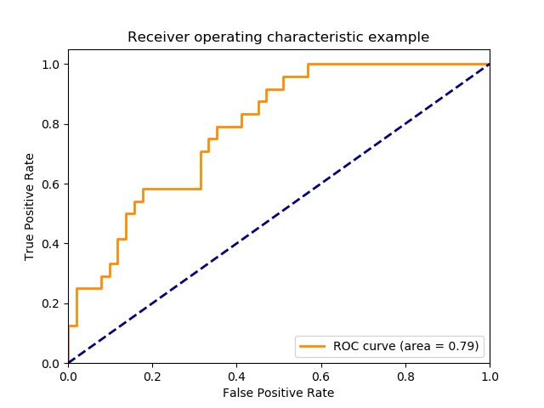
ROC curve

Slide 25
Thresholds
If we are using logistic regression as a classifier (training a model to have optimal validity (sensitivity and specificity) and then applying it to a test set for classifying observations with unknown true values, we can set a threshold for what predicted probabilities will classify someone as a 1 vs. a 0 (e.g. diabetes vs. no diabetes)
The blue dashed line in the ROC curve figure is for different threshold values (predicted probabilities for classifying an observation as having the characteristic). Thresholds range range from 1 in the lower left corner (100% specific) to 0 in the upper right corner (100% sensitive)

Slide 26
Plotting ROC curves–we use functions in the ROCR package
preds<-predict(bmi_cont_logit_b, newdata=BRFSS_balance, type='response') #get predicted probabilities from the model (bmi_catLogitb) and the actual values for diabetes from the BRFSS_balance dataset ROCR=prediction(as.numeric(preds), as.numeric(BRFSS_balance$diabetes_binary)) #predicted probs, values of dependent variable. *Note need as.numeric specification for below perf=performance(ROCR,"tpr", "fpr") # trp is what to plot on y axis and fpr is what to plot on x axis plot(perf, colorsize=T, color="red", print.cutoffs.at=seq(0,1,0.1)) abline(a=0, b= 1)

Slide 27
How do we obtain the threshold value from the curve with the highest sensitivity and specificity?
ss <- performance(ROCR, "sens", "spec") plot(ss) ssval<-ss@alpha.values[[1]][which.max(ss@x.values[[1]]+ss@y.values[[1]])] ssval

Slide 28
Set threshold at 0.5071659 and get “confusion matrix” (just a two by two table)
t=0.5071659 pred_class=ifelse(preds>t, 'Diabetes','No Diabetes') addmargins(table(pred_class=pred_class,observed=BRFSS_balance$diabetes_binary))
sensitivity=4147/(5907) #also known as recall sensitivity specificity=3866/(5859) specificity PPV=4147/(6140) #also known as precision PPV accuracy=(4147+3866)/(11766) accuracy

Slide 29
Area under the ROC curve (AUC)
AUC tells us how good our model is at distinguishing between classes
It tells us the probability that a randomly chosen true positive case will be ranked higher than a randomly chosen negative case
The higher the AUC, the better it is at predicting 1’s (or determining patients with diabetes vs. without diabetes)
An AUC of 0.5 means you could just as well flip a coin to determine who has diabetes and who does not AUC=1 AUC=0.7 AUC=0.5

Slide 30
To get the AUC we can use the performance function
auc.perf = performance(ROCR, measure = "auc") auc.perf@y.values

Slide 31
What happens to our AUC if we add income to our model?
bmi_cont_logitc <- glm(diabetes_binary ~bmi + X_AGE80 + sex + income, data=BRFSS_balance, family="binomial") summary(bmi_cont_logitc) preds<-predict(bmi_cont_logitc, newdata=BRFSS_balance, type='response') ROCR=prediction(as.numeric(preds), as.numeric(BRFSS_balance$diabetes_binary)) #predicted probs, values of dependent variable auc.perf = performance(ROCR, measure = "auc") auc.perf@y.values

Slide 32
Limitations of using logistic as a classifier
Many problems in public health are multifactorial and rare leading to unbalanced samples (where classification requires balancing to perform at acceptable levels of sensitivity and specificity)
Training a model using an artificially balanced sample may not be generalizable to a test set
Difficult to predict whether something is or is not when risk factors are weak–better to use logistic regression to estimate risk or the probability of developing an outcome

Slide 33
Refs
https://www.r-bloggers.com/a-small-introduction-to-the-rocr-package/ https://www.youtube.com/watch?v=7eHumx3-xR0 https://towardsdatascience.com/understanding-auc-roc-curve-68b2303cc9c5 https://en.wikipedia.org/wiki/Receiver_operating_characteristic https://www.knime.com/blog/correcting-predicted-class-probabilities-in-imbalanced-datasets https://www.fharrell.com/post/classification/

